Slide 1
P740
Numerical Differential Busbar Protection
PRESENTATION
Notes:
Notes

Slide 2
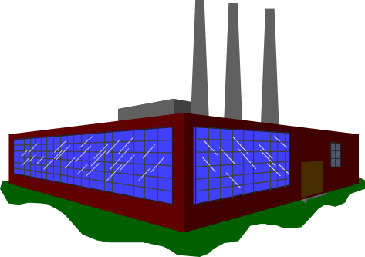
Busbar Protection
Kirchhoff’s Principle applied to a healthy system
Σ I = 0
I₁
I₂
I₃
I₁ = I₂ + I₃
I₁ - I₂ - I₃ = 0
Notes:
The basic principle of busbar protection is very simple.
The sum of the currents flowing into the protected area must be equal the sum of the currents flowing out of the protected area.

Slide 3
Busbar Protection
Kirchhoff’s Principle applied to a system with a fault
Σ I ≠ 0
I₁
I₂
I₃
I₁ ≠ I₂ + I₃
I₁ - I₂ - I₃ ≠ 0 = I_{F}
Notes:
Under fault conditions this is not true as some of the current flowing into the protected area is ‘lost’ to the fault.

Slide 4
Complicate Configuration
BS
Zone 1
Zone 2
Zone 3
Zone 4
BC1
BC2
F1
F2
F3
F4

Slide 5
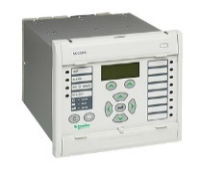
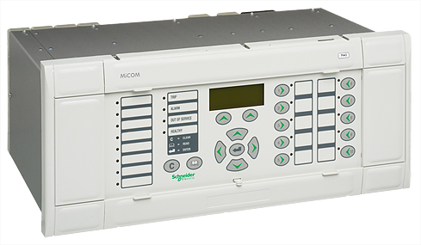
Distributed-Busbar Protection ( single BB):
BB1
BB2
Current
Peripheral units
Fiber Optic
Central unit
Notes:
This slide shows how to select typical modules for a single busbar application.
For each CT location one peripheral unit must be selected from either a P742 or P743 modules. (note that for the above application, P743 is not required as the i/o requirements are small).
In addition to this a central unit P741 has to be selected as well.
The peripheral modules are the ‘acquisition’ modules for the circuits that make up the busbar configuration. They accept the analogue inputs from the CT’s and the auxiliary digital inputs from the primary plant.
Note that all CTs do not need to be the same as CT mismatch is catered for, and explained later. Suffice to say that all measurements are taken to a common base.
A graphical topology configurator is used to recreate an accurate representation of the bubar configuration.
Any differential current that is caused by a fault on the busbar is seen by the central unit and acted on accordingly.

Slide 6
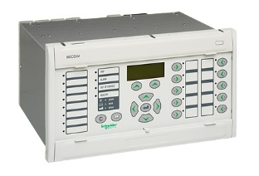
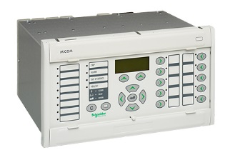
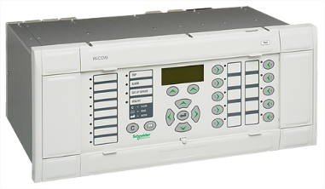
Double Busbar Application
BB1
BB3
BB2
BB4
Current
BB5
*
*
Peripheral units
Fiber Optic
* P743 or P742
Central unit
Notes:
This slide shows the left hand side of a typical double busbar application. The global view is shown on the next slide.
For a double busbar application the scheme is built up in a similar manner.
For each CT location one peripheral unit must be selected from either a P742 or P743 modules.
In addition to this a central unit P741 has to be selected as well.
The peripheral modules are the ‘acquisition’ modules for the circuits that make up the busbar configuration. They accept the analogue inputs from the CT’s and the auxiliary digital inputs from the primary plant.
Note that all CTs do not need to be the same as CT mismatch is catered for, and explained later. Suffice to say that all measurements are taken to a common base.
A graphical topology configurator is used to recreate an accurate representation of the bubar configuration.
Any differential current that is caused by a fault on the busbar is seen by the central unit and acted on accordingly.

Slide 7

Differential Elements

Slide 8
Bias Differential Characteristic
Differential Phase Faults Elements
i_{diff} (t)
TRIPPING AREA
Line I _{diff} = 100% I _{bias}
K>> = 50 to 70%
X
X
kCZ>> = 0 to 70%
i
i
1
i
2
c
X
I_{D}CZ>2
RESTRAIN AREA
1
X
X
2
I_{D}>2
i
i
3
m
k1 = 0 to 50%
I_{D}>1
Differential current: idiffnode1 (t) = i1 + i3 + ic
Differential current: idiffnode2 (t) = ic + i2 + im
Operating current: idiff (t)= |idiffnodeX (t)| = |Σ in|
Zone 1 Bias current: ibiasZ(t) = |i1| + | i3| + |ic| = Σ |in1|
Zone 2 Bias current: ibiasZ(t) = |ic| + |i2| + |im| = Σ |in2|
CZ Bias current: ibiasCZ(t) = |iFeeder1| + … + |iFeederm| = Σ |iFeederm|
i_{bias} Z(t)
i_{bias} CZ(t)
Notes:
The P746 phase fault elements use a biased differential characteristic for operation which is shown above.
The primary protection element of the P746 scheme is phase segregated biased current differential protection. This technique uses nodal analysis throughout the scheme, on a per zone and per scheme basis (-additional topology information is available in the separate topology presentation).
The basic operating principle of differential protection is to calculate the difference between the currents entering and leaving a protected zone - Kirchoffs law. The protection operates when this difference exceeds a set threshold.
Differential currents may also be generated under external fault conditions due to CT saturation or if there is a discrepancy between actual and recording positions of the plant. To provide stability for through fault conditions the relay adopts a biasing technique which effectively raises the setting of the relay in proportion to the through fault current to prevent relay maloperation. For plant discrepancy conditions the check zone prevents maloperation.
The differential current is based on a summation of the currents entering the protected zone. The bias current is the scalar sum of the currents in the protected zone. Each of these calculations is done on a phase per phase basis, for each zone.

Slide 9
Check Zone Supervision
Check Zone element must operate for a bus bar trip command to be issued
  Total I_{diff} = Sum of all the feeder i_{diff}
  i_{diff}(t) CZ = Σ i_{diff}(t) feeder
Any in-zone fault or through fault and some status position discrepancy will be seen as zone differential current
Any in-zone fault will also be seen as a Check (or Total) Zone differential current but because the Check Zone does not take into account the plant status positions, there will be no maloperation in case of through fault and status position discrepancy
Notes:
Check Zone element must operate as well as a zone element in order for a trip command to be issued
Any in-zone fault will be seen as zone differential current. This fault current will also be seen as a check zone differential current.
Under plant discrepancy conditions, for example if the topology thinks an isolator is open but it is actually closed, there will be a differential current generated in the zone. (This is covered in more detail in the topology processing section of the presentation if you choose to cover this element.) This is not seen by the check zone element thereby preventing mal-operation

Slide 10
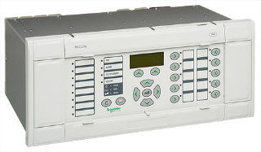
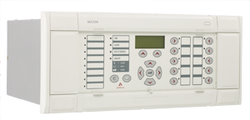
Check Zone Supervision
CASE 1: 2 CT Coupler and CB Closes on to external fault with wrong isolator or CB Status position
ZONE 1
I_{ExtFault}
through CB
ZONE 2
BB1
BB2
CB CLOSED
seen OPEN*
* consequence: CT removed
from Zone 1 and from Zone 2
Notes:
As the CB has closed but the status has not yet been refreshed the topology still believes the CB to be open.
Treating this as an open bus coupler circuit breaker the topology algorithm will have created an end node (EN1). This is located between the CT and the circuit breaker. This then fully replicates the scheme upto the open bus coupler CB on both sides. Note that in this example zone 2’s limits now extend upto the circuit breaker.
If the circuit breaker was open no load current would flow through the circuit breaker and hence the extra node. The differential current in the two main zones would equal zero, as the current flowing into the zones would still equal the current flowing out, and the current measured in the extra node would also be equal to zero.
However, if the circuit breaker is actually closed, the load current will flow through the circuit breaker and hence the extra node. The differential current in main zone 1 will still equal zero, as the current flowing into the zone will still equal the current flowing out, but the current measured in the extra node and in main zone 2 will be equal in magnitude but opposite in sign. (iload)
Zone 1 would not operate and when the check zone element is calculated, the differential currents seen in zone 2 and the extra node (idiffEN), which result from the discrepancy in the plant status, can be seen to be cancelled out.
Check zone Idiff = idiff = idiffZ1+ idiffEN1 + idiffZ2 =0
Again the system retains its stability for discrepancies in plant status.
The differential currents (i_{diff1} and i_{diff2}) which are a resultant of the discrepancy status, are cancelled out in the check zone element

Slide 11
Check Zone Supervision
Case 1
I_{ExtFault}
through CB
ZONE 1
BB1
BB2
ZONE 2
CB CLOSED
seen OPEN*
* consequence: CT removed
from Zone 1 and from Zone 2
ZONE 1
IdiffZ1 = - iExtFault
ZONE 2
IdiffZ1 = + iExtFault
CHECK ZONE
IdiffCZ = - iExtFault + iExtFault = 0
System STABLE in case of CB position discrepancy
Notes:
As the CB has closed but the status has not yet been refreshed the topology still believes the CB to be open.
Treating this as an open bus coupler circuit breaker the topology algorithm will have created an end node (EN1). This is located between the CT and the circuit breaker. This then fully replicates the scheme upto the open bus coupler CB on both sides. Note that in this example zone 2’s limits now extend upto the circuit breaker.
If the circuit breaker was open no load current would flow through the circuit breaker and hence the extra node. The differential current in the two main zones would equal zero, as the current flowing into the zones would still equal the current flowing out, and the current measured in the extra node would also be equal to zero.
However, if the circuit breaker is actually closed, the load current will flow through the circuit breaker and hence the extra node. The differential current in main zone 1 will still equal zero, as the current flowing into the zone will still equal the current flowing out, but the current measured in the extra node and in main zone 2 will be equal in magnitude but opposite in sign. (iload)
Zone 1 would not operate and when the check zone element is calculated, the differential currents seen in zone 2 and the extra node (idiffEN), which result from the discrepancy in the plant status, can be seen to be cancelled out.
Check zone Idiff = idiff = idiffZ1+ idiffEN1 + idiffZ2 =0
Again the system retains its stability for discrepancies in plant status.
The differential currents (i_{diff1} and i_{diff2}) which are a resultant of the discrepancy status, are cancelled out in the check zone element

Slide 12
Check Zone Supervision
CASE 2: 2 CT Coupler with the CB Closed and Fault between a CT and the CB
ZONE 1
BB1
BB2
ZONE 2
Notes:
As the CB has closed but the status has not yet been refreshed the topology still believes the CB to be open.
Treating this as an open bus coupler circuit breaker the topology algorithm will have created an end node (EN1). This is located between the CT and the circuit breaker. This then fully replicates the scheme upto the open bus coupler CB on both sides. Note that in this example zone 2’s limits now extend upto the circuit breaker.
If the circuit breaker was open no load current would flow through the circuit breaker and hence the extra node. The differential current in the two main zones would equal zero, as the current flowing into the zones would still equal the current flowing out, and the current measured in the extra node would also be equal to zero.
However, if the circuit breaker is actually closed, the load current will flow through the circuit breaker and hence the extra node. The differential current in main zone 1 will still equal zero, as the current flowing into the zone will still equal the current flowing out, but the current measured in the extra node and in main zone 2 will be equal in magnitude but opposite in sign. (iload)
Zone 1 would not operate and when the check zone element is calculated, the differential currents seen in zone 2 and the extra node (idiffEN), which result from the discrepancy in the plant status, can be seen to be cancelled out.
Check zone Idiff = idiff = idiffZ1+ idiffEN1 + idiffZ2 =0
Again the system retains its stability for discrepancies in plant status.
The differential currents (i_{diff1} and i_{diff2}) which are a resultant of the discrepancy status, are cancelled out in the check zone element

Slide 13
Check Zone Supervision
CASE 2
Belongs to Z1 & Z2
ZONE 1
BB1
BB2
ZONE 2
CHECK ZONE
IdiffCZ = iFault
Zone 1 and Zone 2 are tripped
Notes:
As the CB has closed but the status has not yet been refreshed the topology still believes the CB to be open.
Treating this as an open bus coupler circuit breaker the topology algorithm will have created an end node (EN1). This is located between the CT and the circuit breaker. This then fully replicates the scheme upto the open bus coupler CB on both sides. Note that in this example zone 2’s limits now extend upto the circuit breaker.
If the circuit breaker was open no load current would flow through the circuit breaker and hence the extra node. The differential current in the two main zones would equal zero, as the current flowing into the zones would still equal the current flowing out, and the current measured in the extra node would also be equal to zero.
However, if the circuit breaker is actually closed, the load current will flow through the circuit breaker and hence the extra node. The differential current in main zone 1 will still equal zero, as the current flowing into the zone will still equal the current flowing out, but the current measured in the extra node and in main zone 2 will be equal in magnitude but opposite in sign. (iload)
Zone 1 would not operate and when the check zone element is calculated, the differential currents seen in zone 2 and the extra node (idiffEN), which result from the discrepancy in the plant status, can be seen to be cancelled out.
Check zone Idiff = idiff = idiffZ1+ idiffEN1 + idiffZ2 =0
Again the system retains its stability for discrepancies in plant status.
The differential currents (i_{diff1} and i_{diff2}) which are a resultant of the discrepancy status, are cancelled out in the check zone element

Slide 14
Topology Processing
BB 1
Isolator Closed
Isolator Closed
Zone 1 = CT1 + CT2
Zone 1 = BB 1
CB Closed
or Open
CB Closed
or Open
CT 1
CT 2
Check Zone = CT1 + CT2
Notes:
A zone is defined from a CT to an other CT or an open electrical element (coupler CB or isolator).

Slide 15
Topology Processing
Bus section closed
BB 1
BB 2
Isolator Closed
Isolator Closed
Zone 1 = CT1 + CT2
Zone 1 = BB1 + BB2
CB Closed
or Open
CB Closed
or Open
CT 1
CT 2
Check Zone = CT1 + CT2
Notes:
A zone is defined from a CT to an other CT or an open electrical element (coupler CB or isolator).
As all the breakers and isolators are closed there is only one zone including BB1 and BB2

Slide 16
Topology Processing
Zone 1
Zone 2
Bus section Open
BB 1
BB 2
Isolator Closed
Isolator Closed
CB Closed
or Open
CB Closed
or Open
CT 1
CT 2
Check Zone = CT1 + CT2
Notes:
A zone is defined from a CT to an other CT or an open electrical element (coupler CB or isolator).
When the bus section is open, a zone is created from each bar feeder CT to that open bus section.
There is one zone for BB1 and one zone for BB2

Slide 17
Topology Processing
Zone 1
CT 3
Zone 2
BB 1
BB 2
Coupling Closed
Isolator Closed
Isolator Closed
CB Closed
or open
CB Closed
or open
CT 1
CT 2
Check Zone = CT1 + CT2
Notes:
A zone is defined from a CT to an other CT or an open electrical element (coupler CB or isolator).
When one CT is used in the coupling and the coupler CB is closed, a zone is created from each bar feeder CT to that coupler CT.
There is one zone for BB1 to CT3 and one zone for BB2 to CT3

Slide 18
Topology Processing
Zone 1
Extended
Zone
Zone 2
BB 1
BB 2
Coupling Open
Isolator Closed
Isolator Closed
CB Closed
or open
CB Closed
or open
CT 1
CT 2
Check Zone = CT1 + CT2
Notes:
A zone is defined from a CT to an other CT or an open electrical element (coupler CB or isolator).
When one CT is used in the coupling and the coupler CB is open, the coupler CT measurement is not taken into account and a zone is created from each bar feeder CT to that open coupler CB.
There is one zone for BB1 and one zone for BB2

Slide 19
Topology Processing
Zone 1
CT 3
CT 4
Zone 2
BB 1
BB 2
Coupling Closed
Isolator Closed
Isolator Closed
CB Closed
or open
CB Closed
or open
CT 1
CT 2
Check Zone = CT1 + CT2
Notes:
A zone is defined from a CT to an other CT or an open electrical element (coupler CB or isolator).
When 2 CTs are used in the coupling and the coupler CB is closed, a zone is created from each bar feeder CT to the opposite coupler CT.
The zone between the 2 coupler CTs belongs to both zones.
There is one zone for BB1 to CT4 and one zone for BB2 to CT3

Slide 20
Topology Processing
Zone 1
CT 3
CT 4
Zone 2
Extended
Zones
BB 1
BB 2
Coupling Open
Isolator Closed
Isolator Closed
CB Closed
or open
CB Closed
or open
CT 1
CT 2
Check Zone = CT1 + CT2
Notes:
A zone is defined from a CT to an other CT or an open electrical element (coupler CB or isolator).
When 2 CTs are used in the coupling and the coupler CB is open, the coupler CTs measurements are not taken into account and a zone is created from each bar feeder CT to that open coupler CB.
There is one zone for BB1 and one zone for BB2.

Slide 21
Topology Processing
Zone 1
Zone 2
1st case: Bus coupler Open
Busbar
The Zones are Extended
The CTs are not taken into account
Overlapped Zones if CB closed
Dead Zone if CB open
2nd case: Bus coupler Closed
Feeder
Zone in Zone 1 and Zone 2
Notes:
As the CB has closed but the status has not yet been refreshed the topology still believes the CB to be open.
Treating this as an open bus coupler circuit breaker the topology algorithm will have created an end node (EN1). This is located between the CT and the circuit breaker. This then fully replicates the scheme upto the open bus coupler CB on both sides. Note that in this example zone 2’s limits now extend upto the circuit breaker.
If the circuit breaker was open no load current would flow through the circuit breaker and hence the extra node. The differential current in the two main zones would equal zero, as the current flowing into the zones would still equal the current flowing out, and the current measured in the extra node would also be equal to zero.
However, if the circuit breaker is actually closed, the load current will flow through the circuit breaker and hence the extra node. The differential current in main zone 1 will still equal zero, as the current flowing into the zone will still equal the current flowing out, but the current measured in the extra node and in main zone 2 will be equal in magnitude but opposite in sign. (iload)
Zone 1 would not operate and when the check zone element is calculated, the differential currents seen in zone 2 and the extra node (idiffEN), which result from the discrepancy in the plant status, can be seen to be cancelled out.
Check zone Idiff = idiff = idiffZ1+ idiffEN1 + idiffZ2 =0
Again the system retains its stability for discrepancies in plant status.

Slide 22
Topology Processing
CT 3
CT 4
CT 3&4 not taken into account
BB 1
BB 2
Coupling Closed
Zone 1 = CT1
Zone 2 = CT2
Zone 1 = BB1
Zone 2 = BB2
Isolator Closed
Isolator Closed
CB Closed
or open
CB Closed
or open
CT 1
CT 2
Check Zone = CT1 + CT2
Notes:
A zone is defined from a CT to an other CT or an open electrical element (coupler CB or isolator).
When 2 CTs are used in the coupling and the coupler CB is closed but a coupler isolator is open, the coupler CTs measurements are not taken into account and a zone is created from each bar feeder CT to that open coupler isolator.
The zone between the 2 coupler CTs belongs to the closed isolator zone.
There is one zone for BB1 to the open isolator and one zone for BB2 to the open isolator.

Slide 23
Topology Processing
CT 3
CT 4
CT 3&4 not taken into account
Extended
Zone
BB 1
BB 2
Zone 1 = CT1
Zone 2 = CT2
Zone 1 = BB1
Zone 2 = BB2
Coupling Open
Isolator Closed
Isolator Closed
CB Closed
or open
CB Closed
or open
CT 1
CT 2
Check Zone = CT1 + CT2
Notes:
A zone is defined from a CT to an other CT or an open electrical element (coupler CB or isolator).
When 2 CTs are used in the coupling and the coupler CB is open and a coupler isolator is open, the coupler CTs measurements are not taken into account and a zone is created from each bar feeder CT to the open CB coupler and to the open coupler isolator.
The zone between the 2 coupler CTs belongs to the closed isolator zone.
There is one zone for BB1 to the open breaker and one zone for BB2 to the open isolator.

Slide 24
Topology Processing
BB 1
BB 2
Zone 1 = CT1
Zone 2 = CT2
Zone 1 = BB1
Zone 2 = BB2
CT 1
CT 2
Check Zone = CT1 + CT2
Notes:
A zone is defined from a CT to an other CT or an open electrical element (coupler CB or isolator).

Slide 25
Topology Processing
BB 1
Isolator opened
CT 1
Dead Zone
CB closed
Bus Bar Protection

Slide 26
P740 Architecture

Slide 27
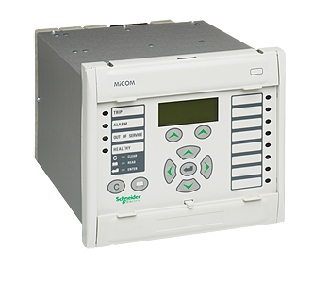
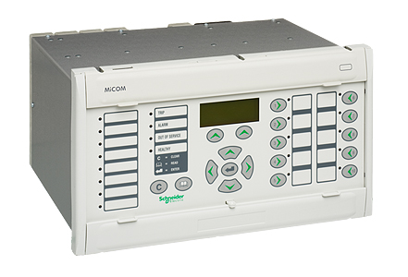
P740 Features
Programmable
Scheme Logic
Measurements
Busbar
Protection
Commissionning
Tools
Redundant
Ethernet
Board
Check Zone
Overcurrent
Protection
Continuous
Monitoring
CB Failure
Protection
Dead Zone
Protection
Disturbance
Recorder
Function Keys
CT & VT
Supervision
CB and Isolator
Supervision
Event & Fault
Records
Tricolour
LEDs

Slide 28
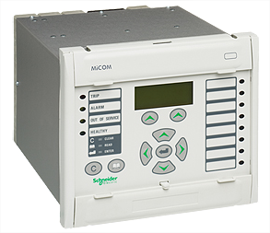
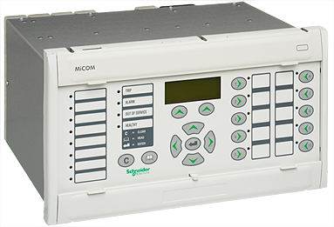
P740 Architecture
The MiCOM P740 scheme is made of:
  P741 - Central Unit (CU)
    Gathers and processes the measurements from the PUs, with Ethernet board, Redundant Ethernet board, hotkeys & function keys and tricolour LEDs
    (all differential protection algorithms)
  P742 - Peripheral Unit (PU)
    Measures and trips, with hotkeys
    (CT saturation detection, local non-directional overcurrent, local circuit breaker failure protection and Dead Zone protection)
  P743 - Peripheral Unit (PU)
    same as P742 but with additional opto inputs, relay outputs and Ethernet board, Redundant Ethernet board, hotkeys & function keys and tricolour LEDs

Slide 29
P740 Architecture
A MiCOM P740 scheme supports , per Central Unit :
  up to 28 Peripheral Units (one PU per CT)
  up to 8 zones (with or without SDEF*),
  up to 28 feeders.
Architecture can be either distributed, centralised or mixed
It is possible to install several Central Units for a given substation.
* : SDEF is the Sensitive Differential Earth Fault

Slide 30
P740 Architecture – Centralized solution
The Central Unit (CU) and the Peripheral Units (PU)
are mounted in one or more cubicles.
This architecture is ideal for the refurbishment of existing substations

Slide 31
P740 Architecture – Distributed Solution
The Peripheral Units are installed in individual switchgear bays distributed around the substation
The maximum fibre optic length between the
Peripheral Units and the Central Unit is 1 km
That leads to wiring cost reduction

Slide 32
P740 Central Unit

Slide 33
Central Unit - P741
Size:
19 inches - 4U
Up to 7 Communication boards
  4 Peripheral Units per
  communication board
1 Main
Processor board
&
1 Coprocessor
board
8 Opto inputs
Optional Irig-B board
(GPS Time Sync)
8 Relay outputs
16 virtual Inputs
/ 16 virtual outputs
Redundant Ethernet board
(IEC 61850-8.1 protocol)
Notes:
The CU has only 8 inputs and 8 outputs.
The majority of the space in the module is taken up with communication boards which accommodate 4 PU channels on each board. This allows the CU to marshal up to 28 PUs.
There is one main processor board and one coprocessor board. It is the coprocessor that handles all of the processes associated with the busbar protection.
The module has 22 LEDs some of which are user programmable although it must be noted that some of these are pre allocated to specific functions dependant on the default PSL that is loaded.
A 3 lines back lit LCD provides local indication of measurements and event/fault records.

Slide 34
Central Unit - P741 - HMI
Size:
19 inches - 4U
Black lit liquid
Crystal display
For indication of
measurements and
event/fault records.
10 Programmable
Function Keys & 2 Hotkeys
22 LEDs
(18 three-coloured
programmable LEDs)
Battery memory enables
memorisation of
the scheme topology.
Notes:
The CU has only 8 inputs and 8 outputs.
The majority of the space in the module is taken up with communication boards which accommodate 4 PU channels on each board. This allows the CU to marshal up to 28 PUs.
There is one main processor board and one coprocessor board. It is the coprocessor that handles all of the processes associated with the busbar protection.
The module has 22 LEDs some of which are user programmable although it must be noted that some of these are pre allocated to specific functions dependant on the default PSL that is loaded.
A 3 lines back lit LCD provides local indication of measurements and event/fault records.

Slide 35
P740 Peripheral Units
Notes:
There are two types of hardware in a P740 Busbar protection Scheme.
The Central Unit, CU, which marshals and operates on the system signals. There is only one model of the CU which is known as the P741.
The Peripheral Unit, which collects both analogue and digital information from the associated circuit. There are two models of the PU which are known as the P742 or P743. The latter is used when the i/o requirement exceeds the capability of the P742. Both are descibed on the following slides to enable the correct unit to be selected.

Slide 36
Peripheral Unit - P742
Size:
8 inches - 4U
16 Opto inputs
8 Relay outputs
(Up to 4 HSHB)
Optional Irig-B board
(GPS Time Sync)
1 Main Processor board
&
1 Coprocessor board
Current inputs : 3 phase
+ 1 residual current inputs
  Dual rated current inputs (1/5A)
Notes:
There are two models of the PU.
The P742 has 16 inputs and 8 outputs whilst the P743 has 24 inputs and 16 outputs.
The increased i/o is not the only difference between them:
No slot for Ethernet board is available in P743 nor
Function keys (10 direct programmable commands in the PSL) only
Hotkeys
There are 3 phase current inputs and one residual current input.
Communication with the central unit is via a pair of fibre optics.
There is one main processor board and one coprocessor board. It is the coprocessor that handles all of the processes associated with the busbar protection.
Local busbar protection confirmation is incorporated in the PU together with local overcurrent protection.
The module has 12 LEDs some of which are user programmable although it must be noted that some of these are allocated to specific functions dependant on the default PSL that is loaded.
A 3 lines back lit LCD provides local indication of measurements and event/fault records.
A battery backed memory enables memorisation of the scheme topology.
Circuit breaker fail is initiated locally for the circuit with which the PU module is associated.

Slide 37
HMI Peripheral Unit - P742
Size:
8 inches - 4U
Black lit liquid
Crystal display
provides local indication of
measurements and
event/fault records.
12 LEDs
Battery memory enables
memorisation of
the scheme topology.
Notes:
There are two models of the PU.
The P742 has 16 inputs and 8 outputs whilst the P743 has 24 inputs and 16 outputs.
The increased i/o is not the only difference between them:
No slot for Ethernet board is available nor
Function keys (10 direct programmable commands in the PSL) only
Hotkeys
There are 3 phase current inputs and one residual current input.
Communication with the central unit is via a pair of fibre optics.
There is one main processor board and one coprocessor board. It is the coprocessor that handles all of the processes associated with the busbar protection.
Local busbar protection confirmation is incorporated in the PU together with local overcurrent protection.
The module has 12 LEDs some of which are user programmable although it must be noted that some of these are allocated to specific functions dependant on the default PSL that is loaded.
A 3 lines back lit LCD provides local indication of measurements and event/fault records.
A battery backed memory enables memorisation of the scheme topology.
Circuit breaker fail is initiated locally for the circuit with which the PU module is associated.

Slide 38
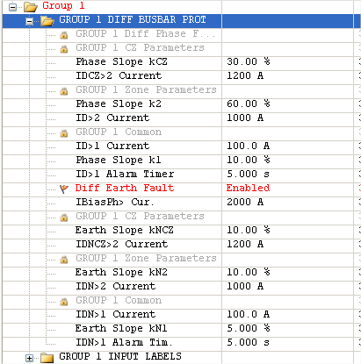
P740 Differential Protection
CHECK ZONE element with bias characteristic.
ZONES parameters
(ID>2, k2, IDN>2, kN)
    CIRCUITRY FAULT elements
    (ID>1, k1)
    [for all zones and check zone elements]
    Single setting for IbiasPh>
    for all zones and check zone elements
    Slopes start from 0 (Is = 0)
Notes:
The Busbar protection is with biased Check Zone (in phase 1 the Check Zone was the threshold ID>2) thus there is:
A set of parameters for all the zones,
A set of parameters for the Check Zone.
All the slopes start from 0.
The circuitry fault criterion is biased with a settable slope

Slide 39
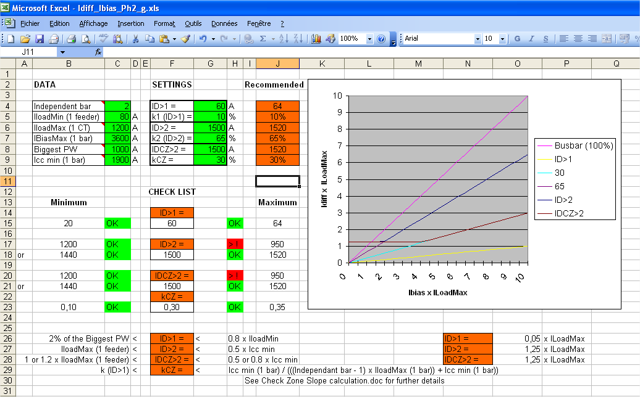
P740 Excel Spreadsheet Tool
Notes:
For Solidly grounded networks or for compensated earthed networks:
This Excel spreadsheet helps to select the parameters and to check that they meet the protection requirements.
It is provided in MiCOM S1 Studio.

Slide 40
P740 Virtual I/O

Slide 41
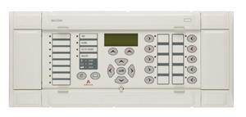
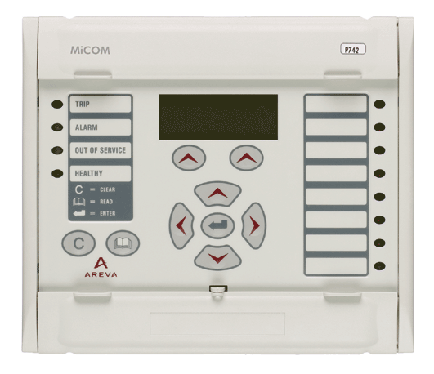
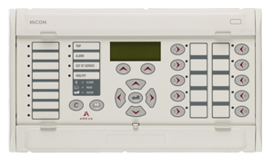
Virtual Inputs/Outputs
P741
Any
P74x
P74x
Feeder
Scheme
Peripheral Units
Fixed information exchanged between the CU & the PUs:
(Busbar Zone 1 … 8 ON/OFF, Busbar Trip 1 … 8 )
CU & PU - Virtual Inputs / Outputs
16 Virtual Intputs can be used to send information from a PU to the CU
  PU -> CU Virtual Signal N°n in the CU is a logical OR of the PU -> CU Virtual Signals N°n in the PUs
16 Virtual Outputs can be used to send information from the CU to the PUs
  CU -> PU Virtual Signal N°n in the PU is the CU -> PU Virtual Signal N°n in the CU
Notes:
This slide shows the interconnection of three modules.
Each PU has a single pair of transmit and receive fibre optic outputs whilst the CU can accommodate upto 28 pairs of inputs from the system PUs.
The data rate is 2.5Mbits to facilitate the data exchange rate required for the security and speed of the protection scheme as a whole.
Fibre optic specifications as follows:
850nm
Standard ST connectors
Optical budget limits distances between modules in a decentralised system to 1km

Slide 42
Disturbance Records

Slide 43
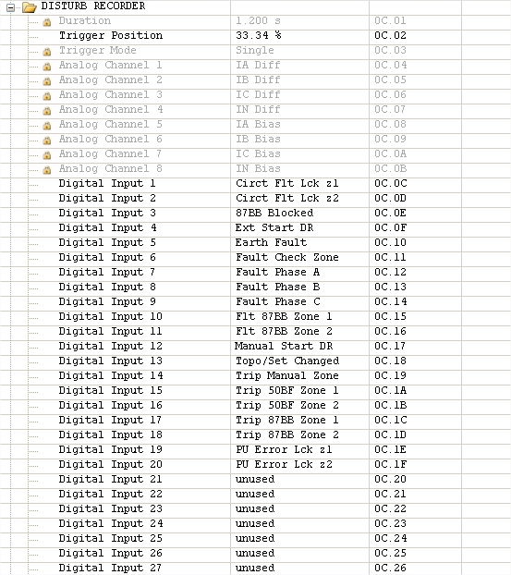
P740 Disturbance Recorder
Disturbance Recorder: Default Setting in CU
Idiff & I bias for each phase of the Check zone
(Extract from Micom S1 Studio)

Slide 44
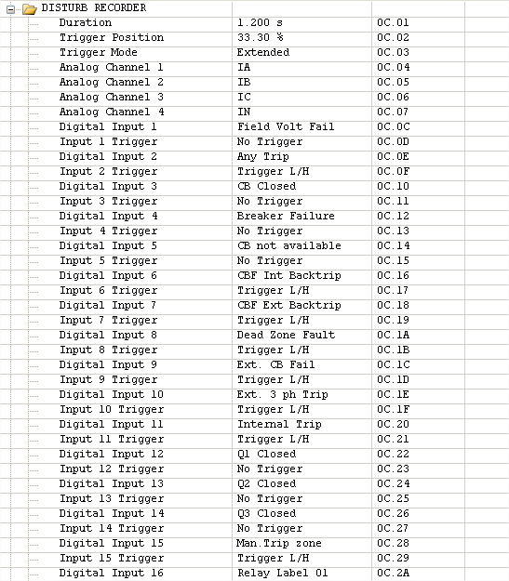
P740 Disturbance Recorder
Disturbance Recorder: Default Setting in PU
currents of each phase

Slide 45
TOOLS

Slide 46
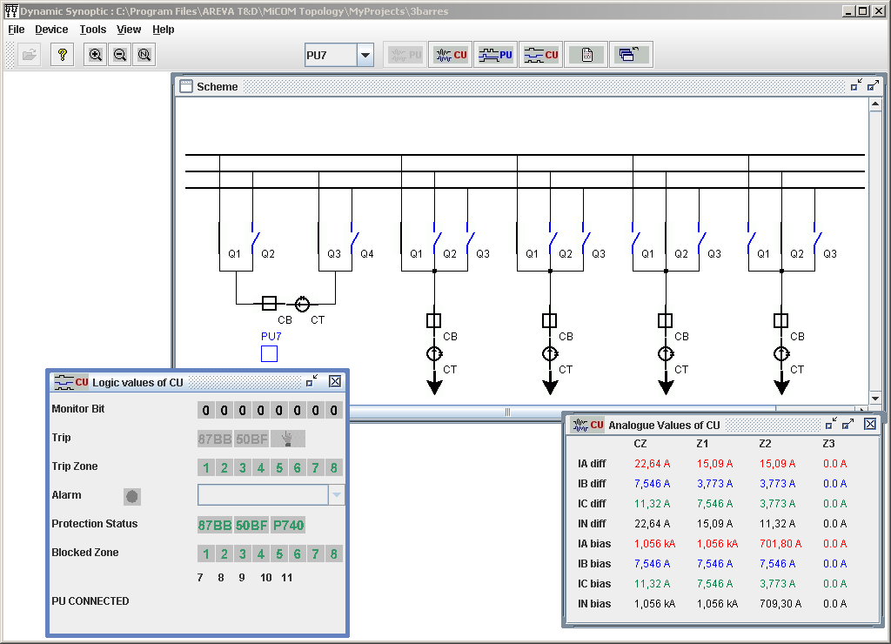
Monitoring Dynamic Synoptic from CU
Notes:
A tool running on a laptop allows to see many information such as:
When connected to the CU or to the rear port:
Position of the isolators, breakers, if they are healthy or not,
Currents of all the zones and the Check Zone,
Information as shown in the CU or any PU

Slide 47
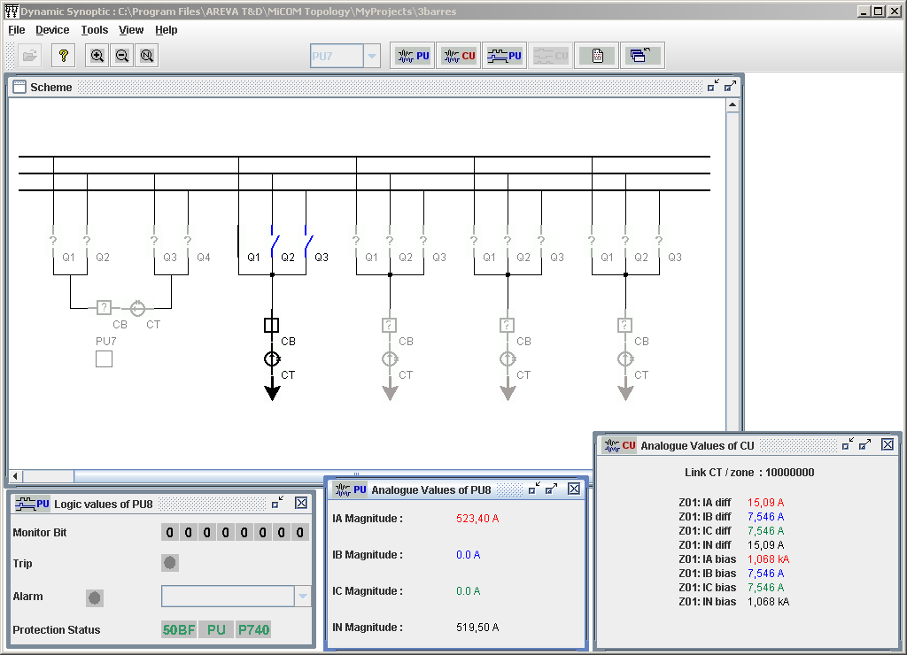
Monitoring Dynamic Synoptic from PU
Notes:
A tool running on a laptop allows to see many information such as:
When connected to a PU:
Position of the isolators, breakers, if they are healthy or not of the connected feeder,
Currents of all the zones and the Check Zone,
Information as shown in the PU

Slide 48
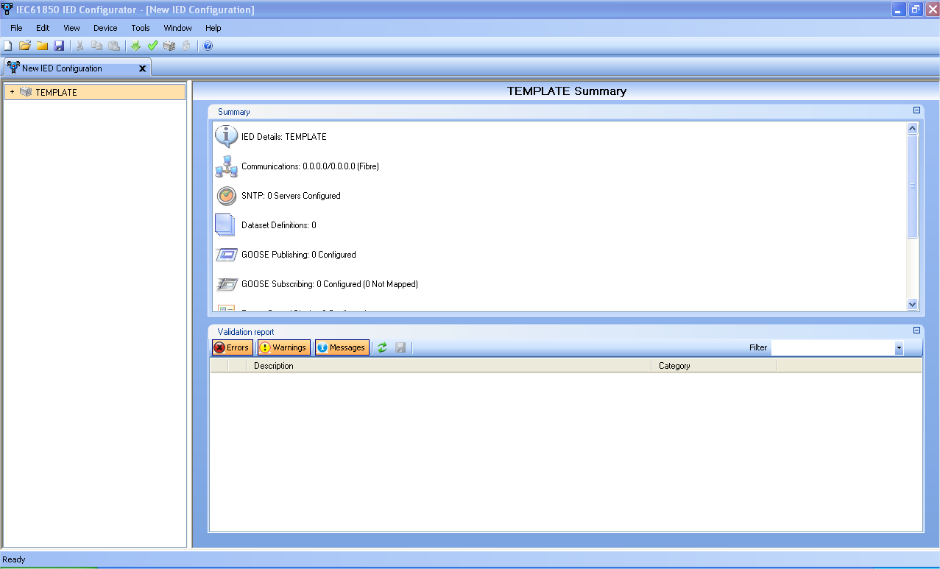
P740 TOOLS
IED Configuration tool:
  To set the Ethernet IEC61850 communication parameters
Notes:
The rear communication port is K-bus OR RS485, courier protocol, IEC61850.
The conversion to IEC 103 is done by a KITZ274 as in phase 1.
A I4X can be used to connect all the relays to a network, courier protocol (not IEC 61850-8-1).

Slide 49
MORE THAN 800 P740 SCHEMES
DELIVERED
SINCE MARCH 2002

Slide 50
Make the most of your energy™

